Slide 1


An Automated Flow for Fast Generation and Verification For Custom CNN AI Accelerators on FPGA Prototyping Systems
Ahmed Emad Ibrahem
Ahmed Hossam Mohamed
Bassem Essam Abdelsadeq
Abdelrahman Khaled Mohamed
Abdelrahman Tarek Mohamed
Mohammed Ahmed Abdelqawy
Under the Supervision of Dr. Karim Ossama Abbas And Dr. Mohamed AbdelSalam
Cairo University

Slide 2
Agenda
Motivation and Background
Methodology
Case Study and Experimental results
Future Work

Slide 3
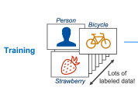
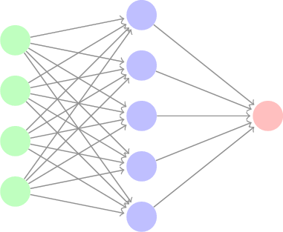
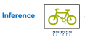
ML Algorithms
Forward
?
“strawberry”
“Bicycle”
Backward
“error”
Model Parameters
Artificial Intelligence
Forward
“Bicycle”
Machine Learning
Deep Learning

Slide 4
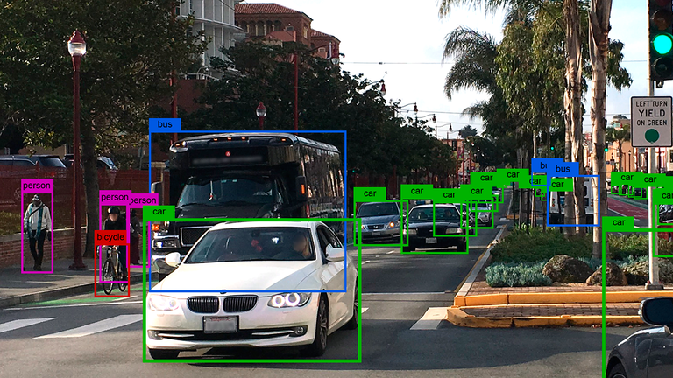
ML Algorithms Applications
Face Recognition.
Classification.
Predict Potential Heart Failure.
Language Translation.
Autonomous Cars.

Slide 5
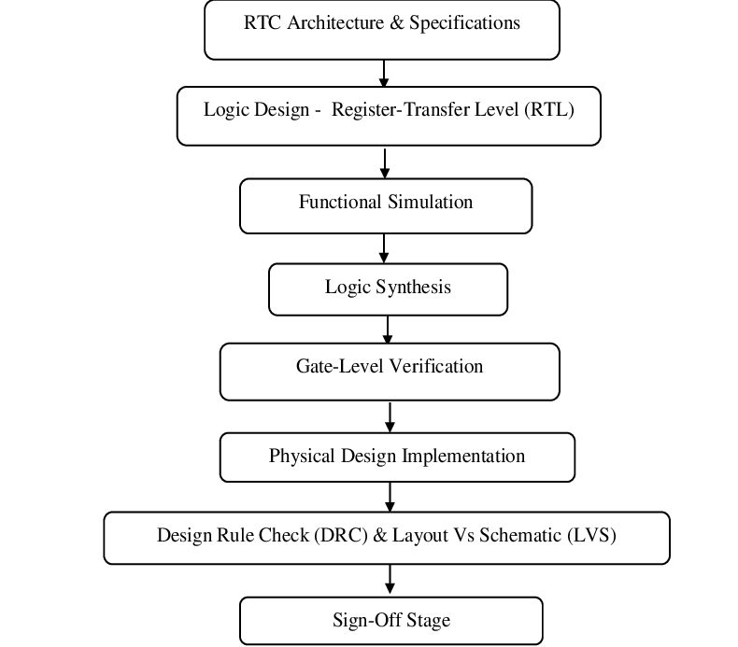
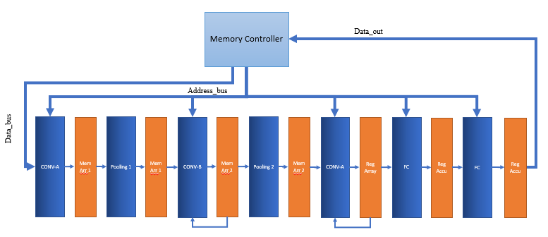
Motivation
Configurations
GUI
Generate rtl
Perl Scripts
Layer Types
Input Size
Input image type ( RGB, Grayscale)
Operation Type ( fixed, float)
Number of Processing units

Slide 6
Contributions
Previous Year:
- Layers:
Standard Convolution Layer.
Average Pooling Layer.
Fully-Connected Layer.
Features:
Square Inputs.
Stride 1.
All layers are automated using Perl scripts.
GUI interface for Perl scripts using MATLAB.
2 Models generated to verify the layers and features.
Current Year:
Layers:
Depth-Wise Convolution Layer.
Winograd-Convolution Layer.
Max Pooling Layer.
Features:
Non-Square Inputs.
Padding.
Stride 2.
Hard-Max Layer.
Flatten.
Batch-Normalization.
All layers are automated using Perl scripts.
GUI interface for Perl scripts using QT.
5 Models generated to verify the new layers and features

Slide 7

Max Pooling Layer
Implemented without using comparators.
Fixed Point: just subtract every 2 number.
Floating Point:
1- Signs
2- Exponent
3- Mantissa

Slide 8
Winograd Convolution
Winograd Operation
DP Implementation
FIFO Operation
Transform Operation
Conva & Convb Operation
Hardware Extension using Perl
Control approach with Hardware Extension
Winograd Conva & Convb Full Architecture
Pipeline Hazard Problem
Pooling Merge
Comparison With Normal Convolution

Slide 9
Previous Operation
Second : Addition
8 Additions
X
+
X
10 | 10 | 10
10 | 10 | 10
10 | 10 | 10
1 | 0 | -1
1 | 0 | -1
1 | 0 | -1
+
*
First : Point wise Multiplication
9 Multiplications
X
+
X
+
X
=
+
0
X
+
+
X
1 Output Cost = 9 Multiplications + 8 Additions
4 Outputs Cost = 36 Multiplications + 32 Additions
+
X
X

Slide 10

WinoGrad Operation
$$y= A^{T}\left[\left(GgG^{T}\right)ₒ\left(B^{T}dB\right)\right]A$$
$$\left(GgG^{T}\right)$$
Second: Point Wise Multiplication
Cost: 16 Multiplications
Filter Window
$$∗$$
First : Filter & Data Transform
Cost : 16 additions
$$\left(B^{T}dB\right)$$
Third : Inverse Transform
Cost :8 Additions
$$\left(ArA^{T}\right)$$
Data Window
Result

Slide 11
Results
Winograd operation Cost | Normal Operation Cost
16 Multiplications + 24 Additions | 36 Multiplications + 32 Additions
Limitations
It only efficient with 3*3 Convolution once the filter size is bigger the transformation matrix values will have numbers and it will need Multipliers
Also it is only valid with stride 1 Convolution because It depends on the overlap of the data
75% of models use stride 1 3*3 Convolution

Slide 12
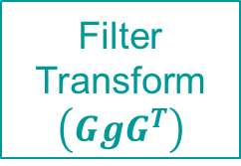
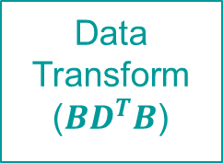
DP Unit Flow
Filter Memory
FIFO
MEM
Filter
Transform
$$\left(GgG^{T}\right)$$
FIFO
Data Transform
($BD^{T}B$)
Point Wise Multiplication
Inv Transform 1
Inv Transform 2

Slide 13
Data Insertion & FIFO Operation
FIFO
Wait 2 CLKS to complete another window
Data Window To be Processed

Slide 14

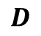
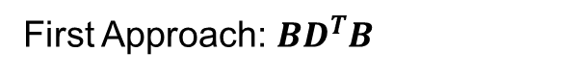

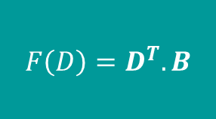
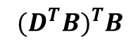
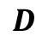
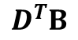
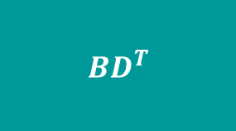
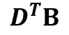
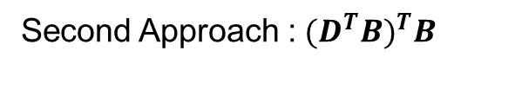
Matrix Transform Operation
Matrix Transform Operation is nesting 2 transform matrices and we have stall Cycle so we may utilize same hardware by rewriting the equation as follows :
$$BD^{T}B={{ (D}^{T}B)}^{T}B$$
First Approach: $BD^{T}B$
Second Approach :${{ (D}^{T}B)}^{T}B$
$$BD^{T}$$
$$DB$$
$${F\left(D\right)=D}^{T}.B$$
$$BD^{T}$$
$$D^{T}B$$
$BD^{T}B$
$$D$$
$$D$$
$$D^{T}B$$
$${{ (D}^{T}B)}^{T}B$$
First Iteration
Second Iteration

Slide 15
Scalable Hardware
The tool allows expansion and contraction of processing units based on available resources
Whenever the computation resources are available
PERL scripts automatically generate associated RTL
DP Unit1
Perl Scripts
DP Unit2
DP Unit3
.
.
.
DP Unit N

Slide 16
Scalable Data Paths
Mem1
DP Unit1
Mem
Mem2
+
MUX
Accumulator
DP Unit1
Mem3
Mem3
IFMS
First Step
Mem4
Mem4
Second Step

Slide 17
Dealing with Complicated Control
Complicated Control
Block 1
Block 2
Block 3
Block 4
CU Signal Start
CU Signal End
Solution
Hazard Control
LD
LD
DT
DT
ML
IT1
IT1
IT2
IT2
R
R
Ac
W
W
1 Unit
LD
DT
DT
R
R
IT1
IT2
IT2
Acc
W
W
R
Ac
W
W
LD
LD
DT
DT
ML
IT1
IT1
IT2
IT2
R
ML
IT1
LD
DT
ML
IT1
IT1
IT2
IT2
R
Ac
W
W
LD
LD
DT
DT
R
IT1
IT2
IT2
Acc
LD
DT
R
R
W
W
ML
IT1
LD
LD
DT
DT
R
R
IT1
IT2
IT2
Acc
W
W
ML
IT1

Slide 18
Pooling Merge
Previous Model
Memory
Memory
Memory
Convolution Layer
Pooling Layer
Winograd Model
Memory
Memory
Convolution Layer
Pooling Layer

Slide 19
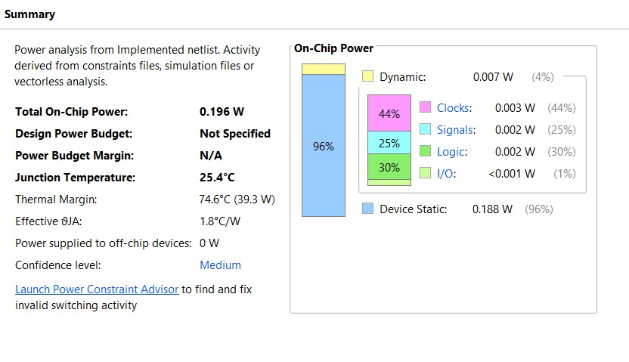
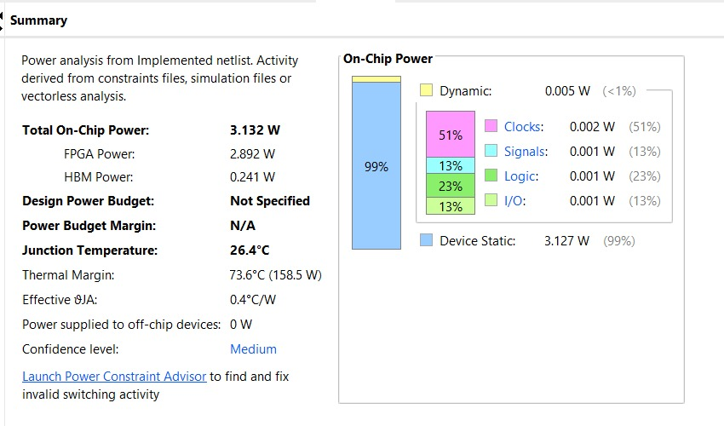
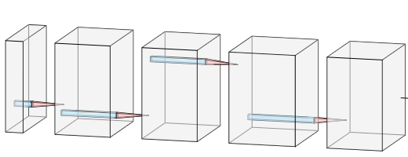
Results of the Drown Model
Winograd Model Power | Normal Model Power
0.188 W | 3.127 W
5 Layers: [ Conv-Pool-Conv-Conv-Pool ]

Slide 20
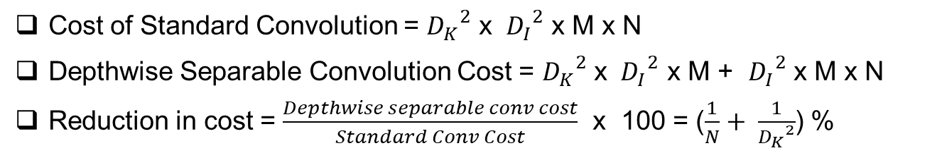
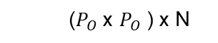
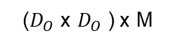
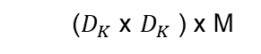
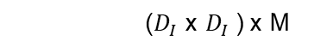
Depth-wise Separable Convolution
Filters
IFMs
OFMs
Filters
…
(1x1) x M
…
….
N
…
…
…
M
($D_{K}$ x $D_{K}$) x M
…
N
($D_{I}$ x $D_{I}$) x M
($D_{O}$ x $D_{O}$) x M
($P_{O}$ x $P_{O}$) x N
(1x 1) x M
Depth-wise
Point-wise
Cost of Standard Convolution = ${D_{K}}^{2}$ x ${D_{I}}^{2}$ x M x N
Depthwise Separable Convolution Cost = ${D_{K}}^{2}$ x ${D_{I}}^{2}$ x M + ${D_{I}}^{2}$ x M x N
Reduction in cost = $\frac{Depthwise separable conv cost}{Standard Conv Cost}$ x 100 = ($\frac{1}{N}+ \frac{1}{{D_{K}}^{2}}$) %

Slide 21
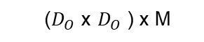
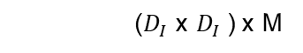
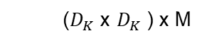
Depthwise Convolution
IFMs
OFMs
Filters
…
…
…
…
…
…
M
M
M
($D_{K}$ x $D_{K}$) x M
($D_{I}$ x $D_{I}$) x M
($D_{O}$ x $D_{O}$) x M

Slide 22
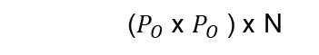
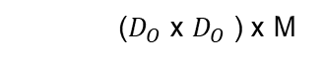
Point wise Convolution
Filters
IFMs
OFMs
…
…
M
(1x1) x M
….
N
…
…
…
…
…
M
N
…
…
M
($D_{O}$ x $D_{O}$) x M
($P_{O}$ x $P_{O}$) x N
(1x 1) x M

Slide 23
Design Flow
Point-wise
Bias 1
PS
Wm1 E2
Depth-Wise
Channel 2
Wm1 E1
Channel 1
Mem
1
Wm2 E2
Wm2 E1
…
N
…
N
3
9
4
5
6
2
3
4
5
6
7
8
9
2
1
1
7
8
…
N
…
N
Bias N
PS
Wm2E2
WmN E1
Mem
N

Slide 24
Padding in CNN
Padding is a term relevant to CNN as it refers to the number of pixels added to an image when it is being processed by the kernel of a CNN to keep the OFM_{SIZE} equals to IFM_{SIZE}.
4.5 | 4 | 4
5 | 5.5 | 5
4 | 4 | 4
0 | 0 | 0 | 0 | 0 | 0 | 0
0 | 1 | 0.5 | 0 | 0.5 | 1 | 0
0 | 0 | 1 | 1 | 0 | 0.5 | 0
0 | 0 | 0 | 1 | 1 | 0 | 0
0 | 0.5 | 0.5 | 1 | 0 | 0.5 | 0
0 | 1 | 0 | 0 | 0.5 | 1 | 0
0 | 0 | 0 | 0 | 0 | 0 | 0
Output without Padding
2.5 | 3.5 | 2 | 3 | 2
2.5 | 4.5 | 4 | 4 | 3
2 | 5 | 5.5 | 5 | 2
2 | 4 | 4 | 4 | 3
2 | 3 | 2 | 3 | 2
Output with Padding

Slide 25
Data Flow
IFM Memory
Convolution Layer
Padding
FSM
CU
Data In
DP
Zero

Slide 26
STRIDE 2
Stride 2 is used to reduce OFM size
0 | 1 | 2 | 3 | 4
5 | 6 | 7 | 8 | 9
10 | 11 | 12 | 13 | 14
15 | 16 | 17 | 18 | 19
20 | 21 | 22 | 23 | 24
54 | 72
144 | 162
Conv 3x3

Slide 27
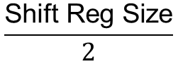
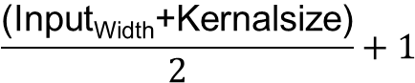
Data Flow
Dual Port Memory
i_shReg_0
23
22
21
20
7
6
13
12
17
16
0
24
11
10
19
18
5
4
1
0
3
2
15
14
0 | 1 | 2 | 3 | 4
5 | 6 | 7 | 8 | 9
10 | 11 | 12 | 13 | 14
15 | 16 | 17 | 18 | 19
20 | 21 | 22 | 23 | 24
i_shReg_1
9
8
o_shReg_8
o_shReg_7
1
0
3
2
15
14
19
18
17
16
11
10
5
4
23
22
7
6
9
8
21
20
13
12
o_shReg_6
1
0
5
4
9
8
11
10
3
2
19
18
21
20
7
6
15
14
17
16
13
12
o_shReg_5
9
8
13
12
1
0
11
10
15
14
5
4
17
16
3
2
19
18
7
6
o_shReg_4
$$\frac{\text{Shift} \text{Reg} \text{Size}}{2}$$
Cycles needed for 1st Window =
o_shReg_3
9
8
1
0
15
14
7
6
13
12
11
12
17
16
3
2
5
4
$$\frac{\text{(}\text{Input}\text{Width}\text{+}\text{Kernalsize}\text{)}}{2}+1$$
Cycles needed for vertical shift =
9
8
13
12
5
4
3
2
11
12
15
14
1
0
7
6
o_shReg_2
Cycles needed for horizontal shift = 1
o_shReg_1
9
8
13
12
5
4
3
2
7
6
11
10
1
0
o_shReg_0

Slide 28
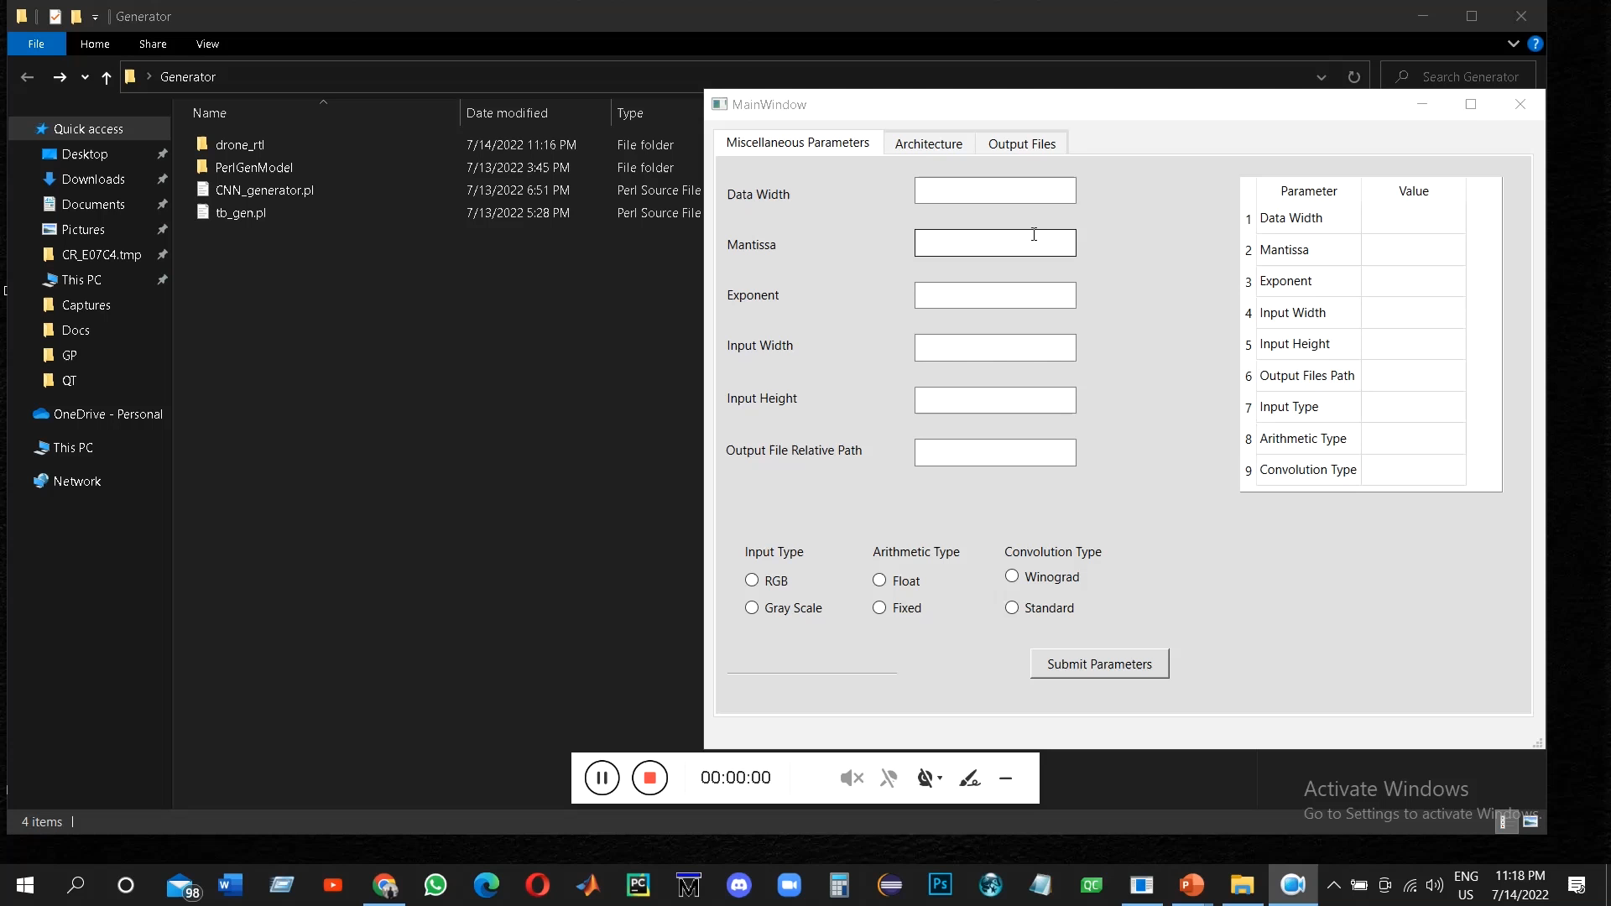
DEMO

Slide 29
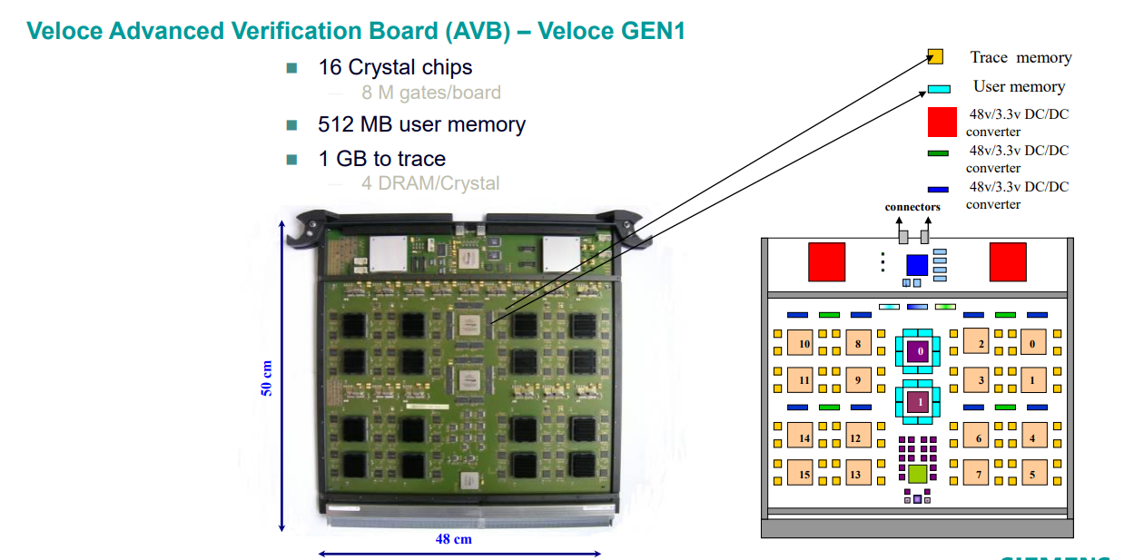
Veloce Emulator
Capacity
Testability
Speed

Slide 30
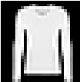
Fashion model
CONV
Maxpool
CONV
Maxpool
CONV
Avgpool
3 x 3
s = 1
2 x 2
s = 2
3 x 3
s = 1
2 x 2
s = 2
3 x 3
s = 1
2 x 2
s = 2
28 x 28 x 1
28 x 28 x 32
14 x 14 x 32
12 x 12 x 64
6 x 6 x 64
6 x 6 x 128
3 x 3 x 128
FC
FC
Maxpooling
Arg-Max
….
….
Padding
Stride 2
Flatten
10
Softmax
128

Slide 31
Results
Maximum Clock Frequency ~ 106 Mhz
Image/sec ~ 740 Image/sec (in Python) ~ 3
Accuracy ~ 98.4% (comparing with python)
Power ~ 7.345 W

Slide 32
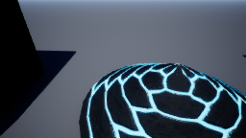
AI-Agent (Drone)
CONV
Maxpool
CONV
CONV
Maxpool
FC
FC
3 x 3
s = 1
2 x 2
s = 1
3 x 3
s = 1
3 x 3
s = 1
2 x 2
s = 1
….
210 x 280 x 3
208 x 278 x 32
207 x 277 x 32
205 x 275 x 64
203 x 273 x 64
202 x 272 x 32
3
Softmax
32
Batch Normalization
Dropout
Maxpooling
Arg-max
Flatten
Non-Square input

Slide 33
Results
Maximum Clock Frequency ~ 101 Mhz
Image/sec ~ 76 Image/sec (in Python) ~ 3
Accuracy ~ 98% (comparing with python)
Power ~ 6.101 W

Slide 34
Future Work
Adding New features
Inception Module
Shuffle layer
Skip Connection feature
Area Tool handling
RISC-V interface with Pulpino SoC.
Dynamic Quantization

Slide 35
Thank You…
Any Questions

